Slide 1


AI in Strategic Decision Making
This presentation explores how AI is revolutionizing decision-making across industries, from retail to healthcare. Learn how AI helps gather and analyze data, leading to faster, more accurate, and consistent outcomes.
by JAYESH JAYANAND

Slide 2
The Rise of AI in Business Decision-Making
Data-Driven Insights
Improved Accuracy
Faster Decision Cycles
AI algorithms analyze vast datasets, uncovering hidden patterns and trends that humans might miss.
AI reduces human error by automating data analysis, resulting in more reliable and objective decisions.
AI streamlines the decision-making process, providing faster insights and allowing organizations to act quickly.

Slide 3
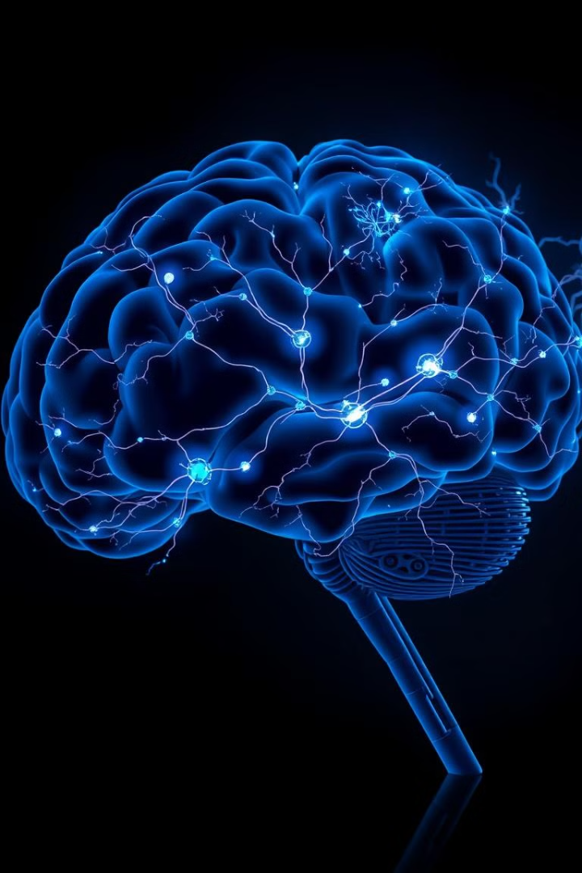
Leveraging AI for Speed, Accuracy, and Consistency
1
Machine Learning
2
Natural Language Processing
AI algorithms learn from historical data to predict future outcomes and inform decision-making.
AI analyzes text data, extracting valuable insights from customer reviews, social media, and other sources.
3
Computer Vision
AI analyzes images and videos, identifying patterns and anomalies, such as defects in manufacturing processes.

Slide 4





Real-World Examples of AI-Powered Decision-Making Across Industries
Retail
Agriculture
AI-powered inventory management and personalized recommendations.
AI-driven precision farming, optimizing resource use and maximizing yield.
Finance
Automotive
AI-powered credit risk assessment and fraud detection.
AI-enabled driving safety features, such as lane departure warnings and adaptive cruise control.

Slide 5



AI in Retail: Optimizing Inventory Management at Walmart
AI-powered forecasting
1
Predicting demand patterns based on historical data and external factors.
Automated replenishment
2
Optimizing inventory levels to minimize stockouts and overstocking.
Reduced waste and increased profits
3
Walmart's AI system saves millions of dollars annually.

Slide 6
AI in Agriculture: Precision Farming at John Deere
Real-time data collection
1
Sensors on tractors and drones gather data on soil conditions, weather, and crop health.
AI-powered analysis
2
Algorithms identify areas that need fertilization, irrigation, or pest control.
Optimized resource use
3
Reducing fertilizer and pesticide use, minimizing environmental impact, and maximizing yield.

Slide 7

AI in Finance: Transforming Credit Risk Assessment
90%
$10M
Accuracy
Savings
AI algorithms have surpassed human analysts in accuracy.
Financial institutions reduce losses by identifying high-risk borrowers.
24/7
Availability
AI systems operate continuously, providing faster and more consistent assessments.

Slide 8




AI in Automotive: Enhancing Driving Safety with Decision Support
Lane Keeping Assist
AI systems monitor lane markings and alert drivers if they drift.
Adaptive Cruise Control
AI adjusts vehicle speed based on traffic conditions and distance to other vehicles.
Automatic Emergency Braking
AI detects potential collisions and automatically applies brakes to avoid accidents.

Slide 9

AI in Healthcare: Early Detection of Sepsis at Johns Hopkins
1
AI-powered monitoring
AI analyzes patient data, identifying early signs of sepsis, a potentially life-threatening condition.
2
Alerting medical staff
AI alerts doctors and nurses to potential cases of sepsis, enabling prompt treatment.
3
Improved patient outcomes
Early detection and treatment of sepsis significantly reduce mortality rates.

Slide 10

Scaling the Adoption of AI-Based Decision-Making: Trust, Access, and Integration
The future of decision-making lies in seamlessly integrating AI into existing workflows. Organizations must build trust in AI systems through transparency, explainability, and ethical considerations.

